Slide 1
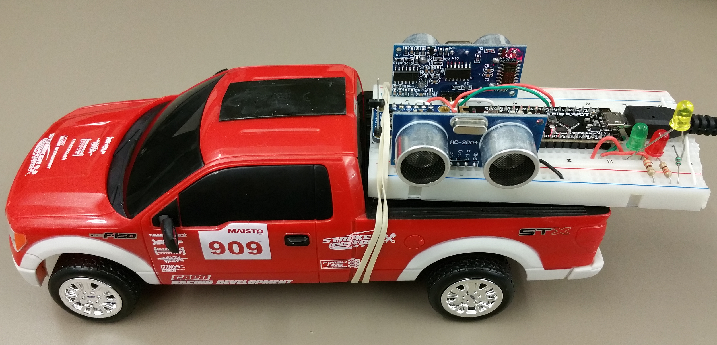
2-D Mapping Robot
By Camilo Moreno and Ahmed Awada

Slide 2
What does it do?
•This project a remote controlled car robot that can create a 2-D map of its surroundings through an Android app.
•Using Bluetooth, the RC car will scan it’s surroundings and create the map from values obtained through the ultrasonic sensors.

Slide 3
Parts Used
•Ultrasonic sensors
•Bluetooth Bluno microcontroller
•Breadboard
•RC Car
USB battery pack

Slide 4
Design
•The basic design of the project is having an RC car with a bread board on the back with the Bluetooth Bluno Microcontroller and the two Ultrasonic sensors connected.

Slide 5
How It Works
•The general idea is that the while the RC car is being driven around, the two ultrasonic sensors are sending out signals that hit objects around it. The sensors pick up this “noise” and relay the values to the Bluetooth Bluno controller, which then sends them to the Android app. The image created reflects any obstacles that the sensors hit which should be represented by dots.

Slide 6
Challenges
•We faced several challenges in this project:
•We wanted to implement a 9DOF Adafruit accelerometer that would track the positioning of the car while it’s moving. Unfortunately we couldn’t get to work right.
•We initially had just one ultrasonic sensor on a servo motor that would rotate 180 degrees back and forth. We decided to have two sensors: one on each side of the car to get better stationary readings.

